Slide 1

Week 1 Module introduction & basic electronics
Fundamentals of IoT
Dr. Eoin Rogers (eoin.rogers@tudublin.ie)

Slide 2
Lesson Outline
Basic introduction to what we will be covering in the class
How the module will be assessed
A (very basic!) introduction to electronics
Overview of this week’s lab (if there’s time)

Slide 3
Course intro
What will we be covering during this course?

Slide 4
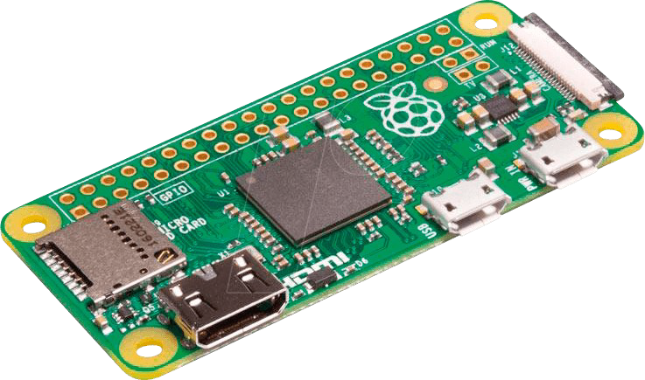
Modern computer hardware is cheap!

Slide 5
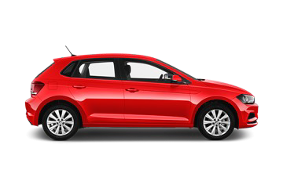
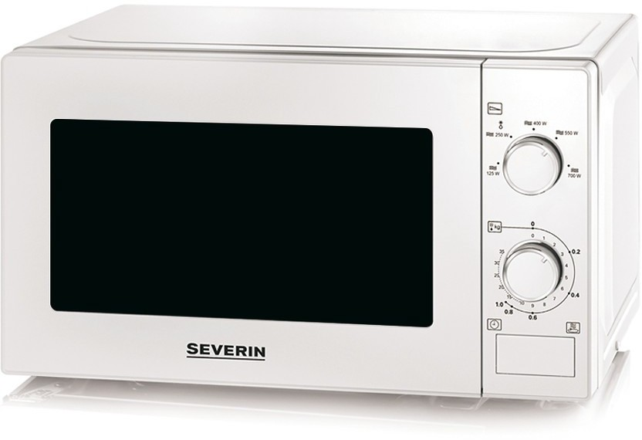
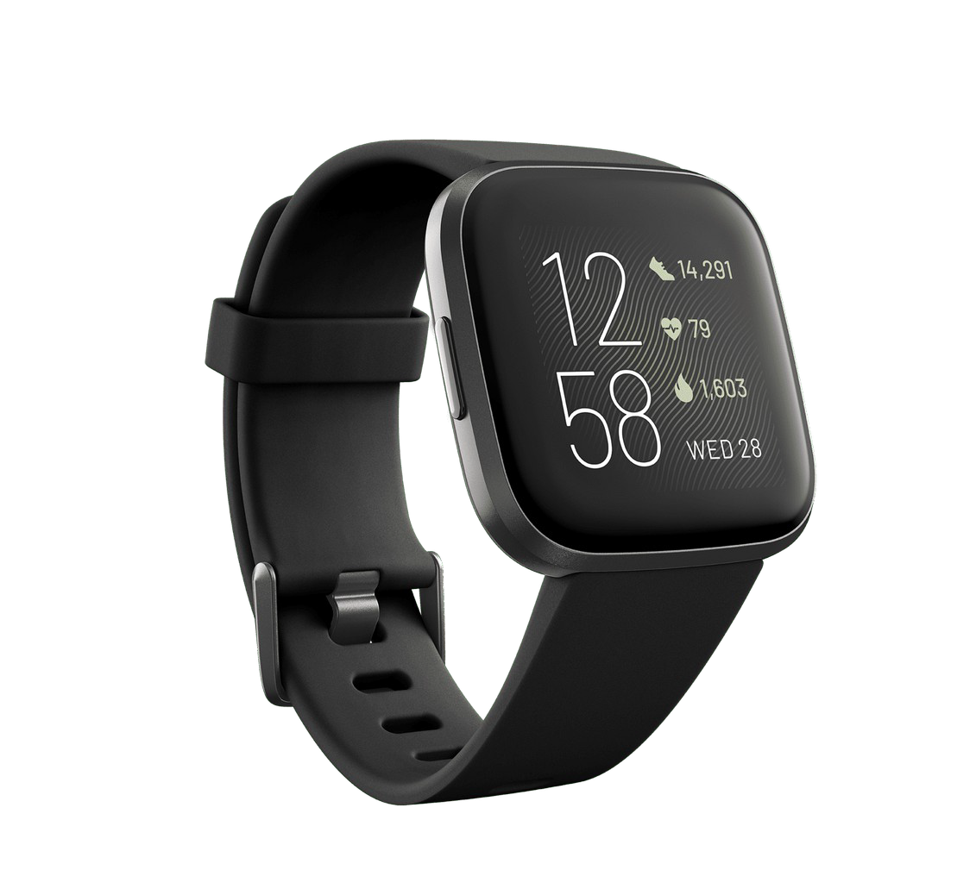
Almost everything contains one...

Slide 6
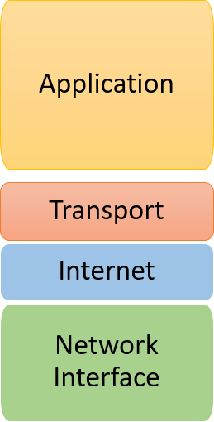
These can be connected together

Slide 7
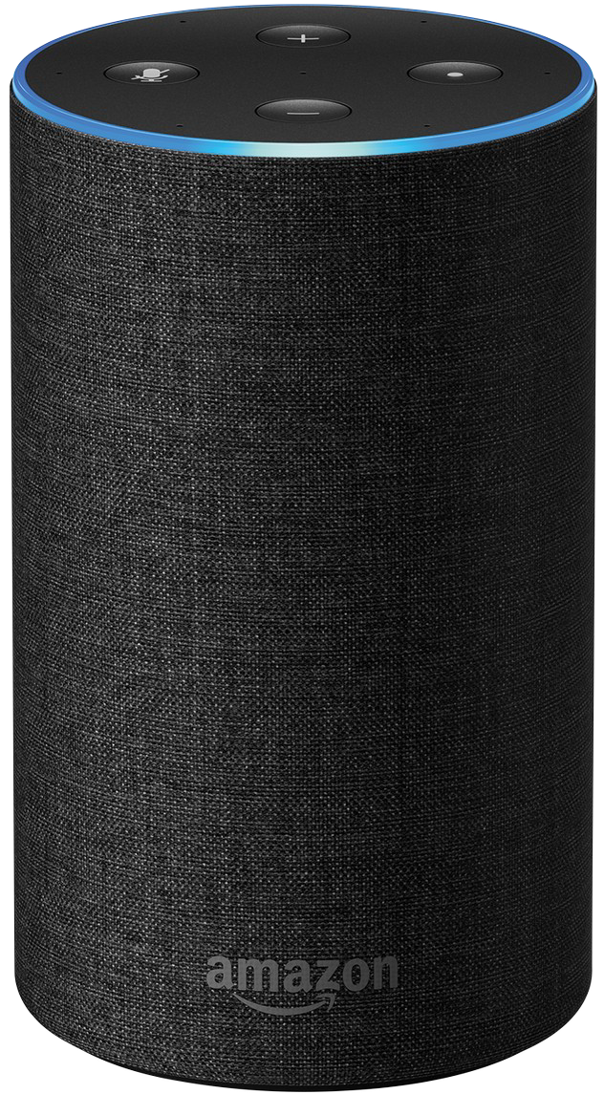
Some useful applications
Smartspeakers
(e.g. Amazon Echo)

Slide 8
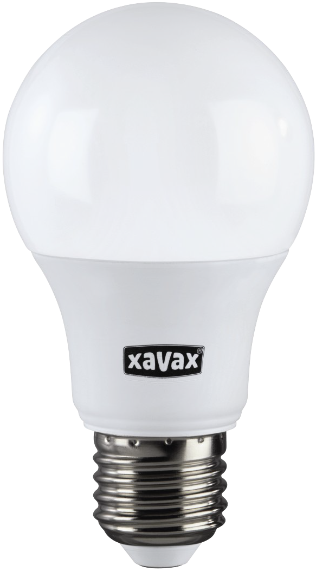
Some useful applications
Smart lighting

Slide 9
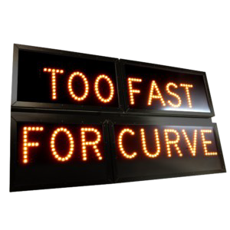
Some useful applications
Electronic road signs

Slide 10
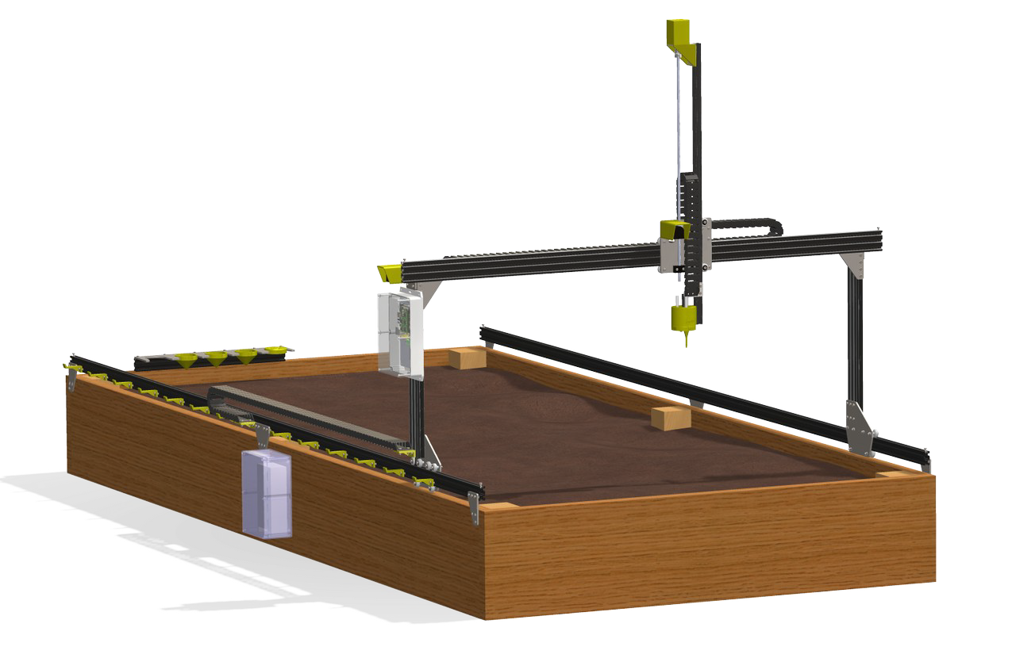
Some useful applications
Agriculture(!)
See farm.bot

Slide 11
What will the course cover?
Low end, cheap hardware platforms
Raspberry Pi
Arduino
How to program these platforms and interface with other hardware
How to offload compute-intensive tasks to external services (i.e. datacentres)
Data visualisation

Slide 12
But we’ll also cover the bad things!
Security
Privacy
Frgmentation and vendor lock-in
Cost
Environmental concerns

Slide 13
Some fundamentals
How is this different from normal computer science?

Slide 14
How is this different from what you’ve seen so far?
Limited computer resources
Closer to the metal (not always bare metal, but often much closer to it!)
Unusual types of input and output (can you think of any examples?)

Slide 15
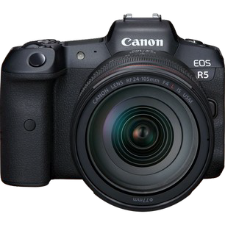
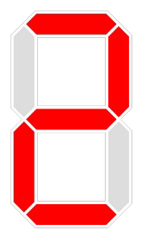
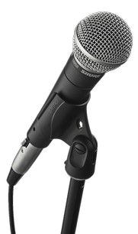

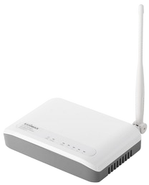
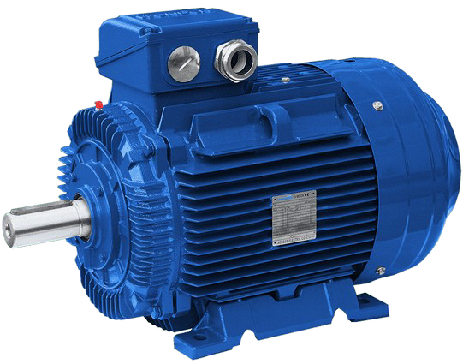
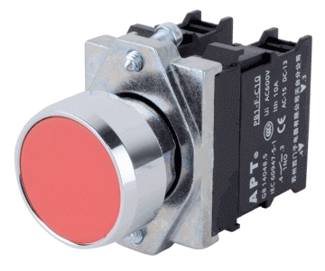
But fundamentally, this is just computer science!
Computer system

Slide 16
Assessment
How is the module marked?

Slide 17
Assessment
60% written exam in January
40% continuous assessment
5 marked labs, each worth 8 marks
Limitations on bringing the hardware off-campus means we can’t do a traditional assignment

Slide 18
Basic electronics
This course is not an electronics course, but knowing some basic electronics terminology can be very helpful!

Slide 19
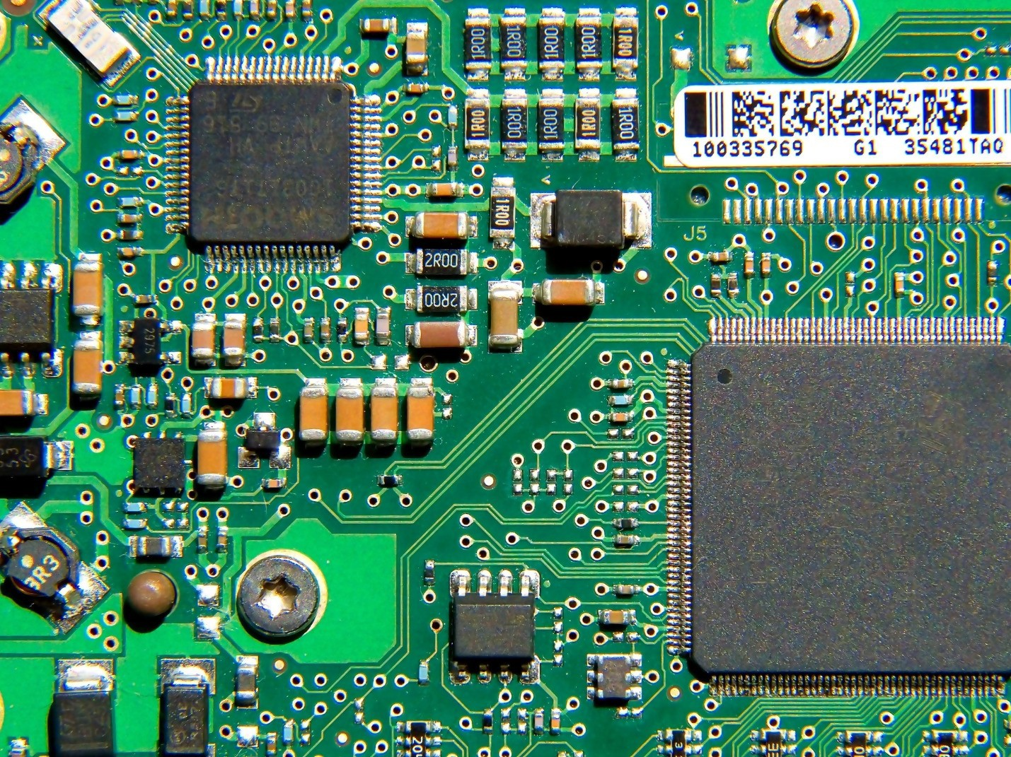
Electronic circuits
A bunch of wires connecting electronic components together

Slide 20
Electronic circuits
At each point/wire, we care about two quantities:
Voltage (V), pressure in the hydraulic analogy
Measured in volts (V)
Current (I), speed in the hydraulic analogy
Measured in amperes (A)

Slide 21
Common electronic components
You might recognise some of these!

Slide 22
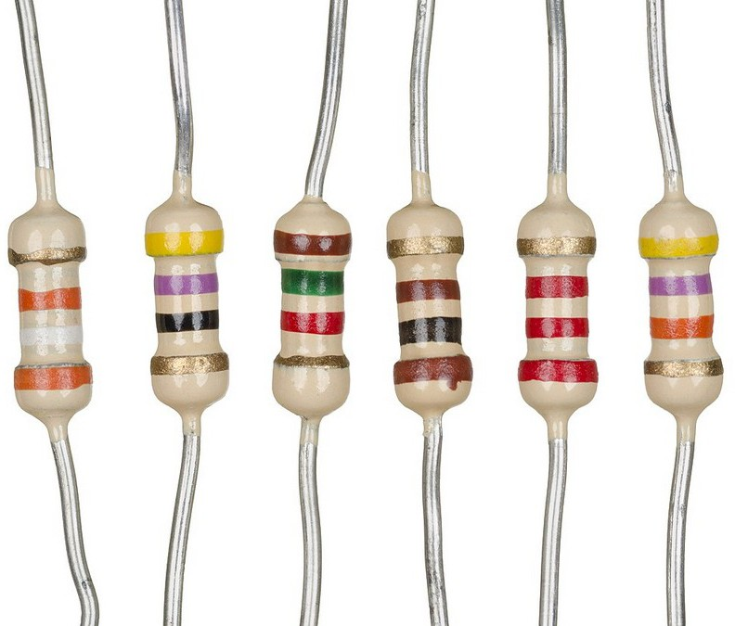
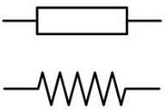
Resistors
Sort of like an electronic speed bump: reduces the voltage and current of the power flowing through it.
The degree of resistance (R) is measured in ohms (Ω).
Resistors are exremely common in real electronic circuits.

Slide 23
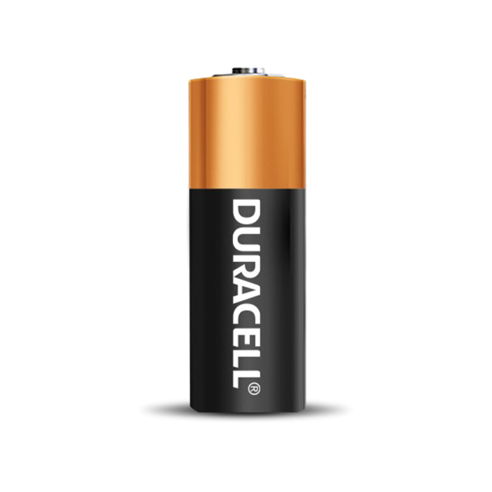
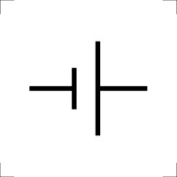
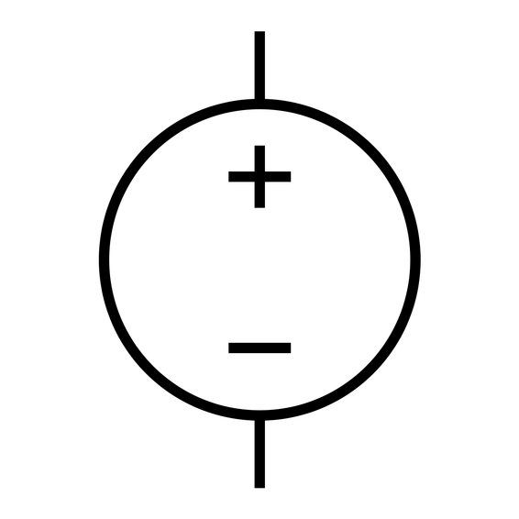
Batteries/voltage sources
Generate electricity with a fixed voltage V.
I think everyone is familier with batteries!

Slide 24
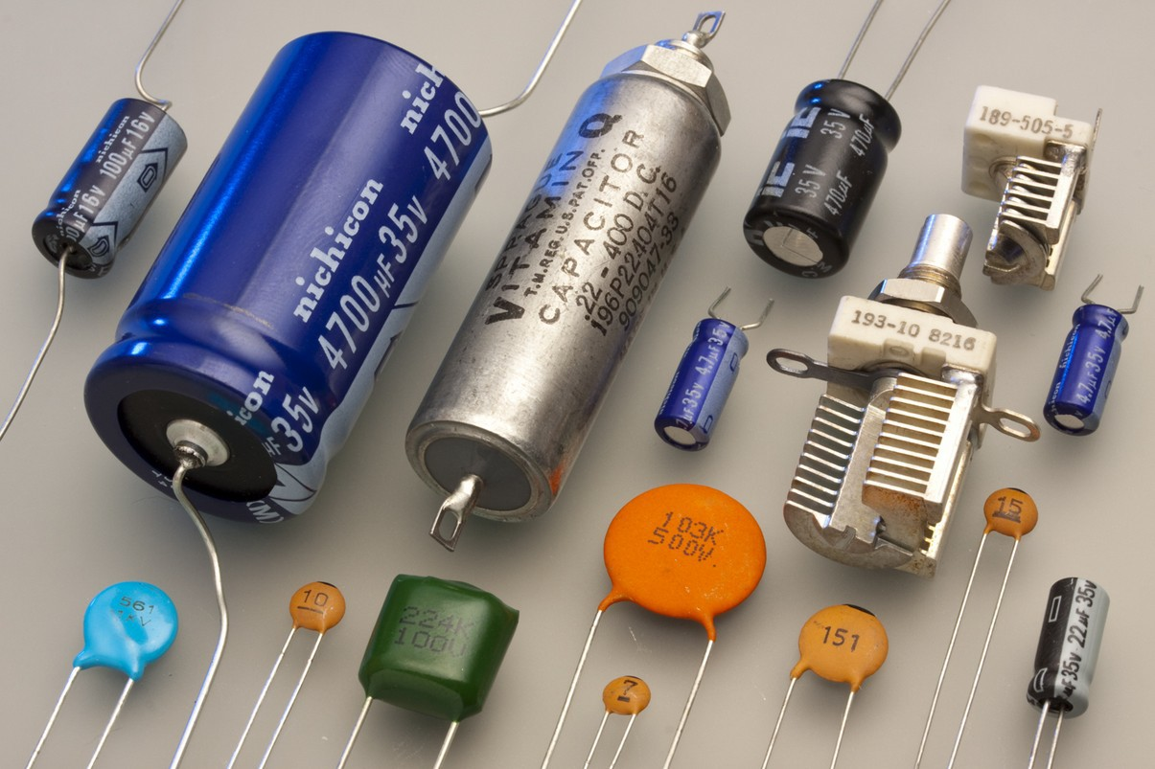
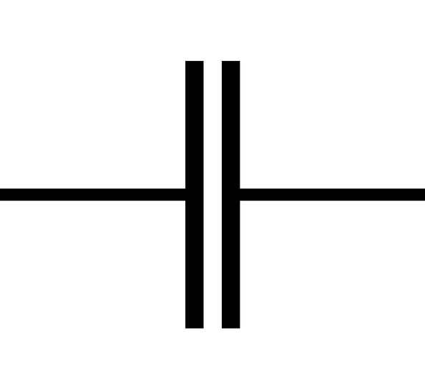
Capacitor
Sort of like a tiny rechargeable battery: stores a small amount of electricity for a period of time. Capacitors use an electric field to store power.
The amount it can store is called the capacitance (C), and is measured in Farads (F).

Slide 25
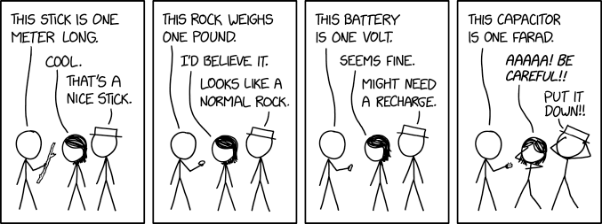
There’s an XKCD for everything...
1 Farad is very large: most capacitors you’d be dealing with have a capacitance measured in milli- or microfarads.

Slide 26
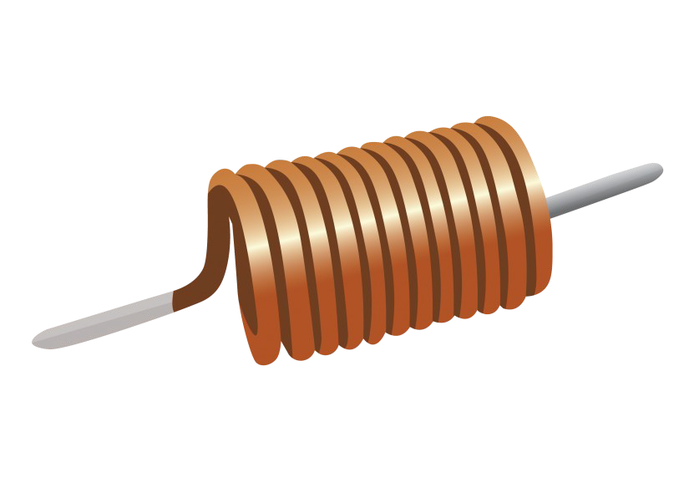
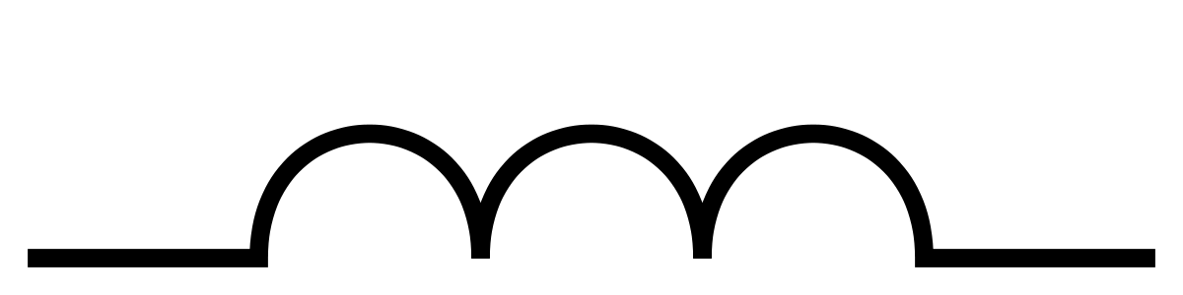
Inductor
Similar to a capacitor, but stores energy in a magnetic field rather than an electric field.
Unlike capacitors, they don’t stop the flow of electricity when fully charged.
The inductance of an inductor (L) is measured in Henries (H).

Slide 27
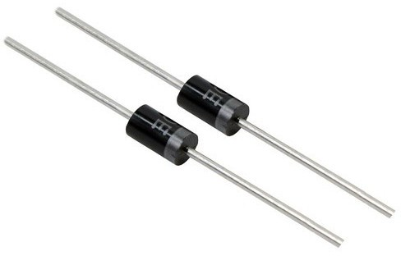
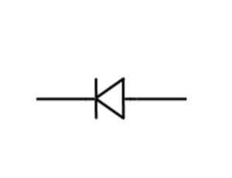
Diode
Only allows electricy to flow in one direction.
Diodes aren’t all that interesting, but light-emitting diodes (LEDs) are obviously common in modern electronics!

Slide 28
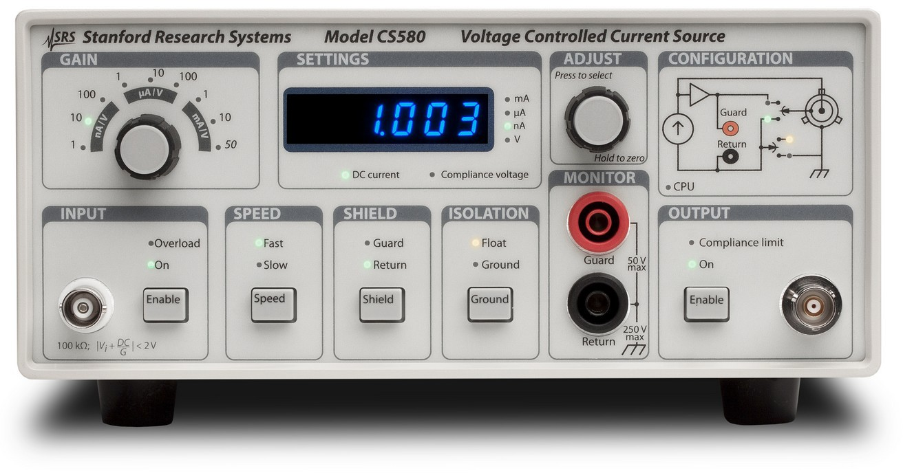
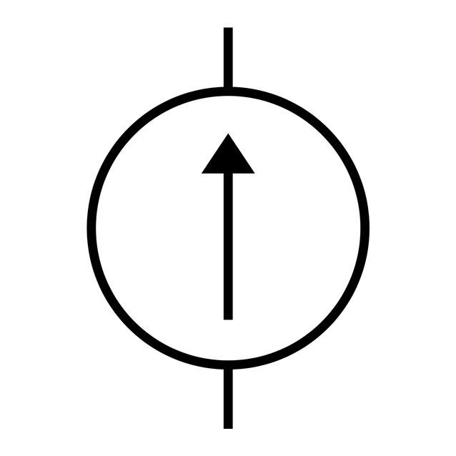
Current source
Like a battery, but generates a fixed current instead of a fixed voltage.
They are infrequently used in real electronics, but are very important in electronics theory.

Slide 29
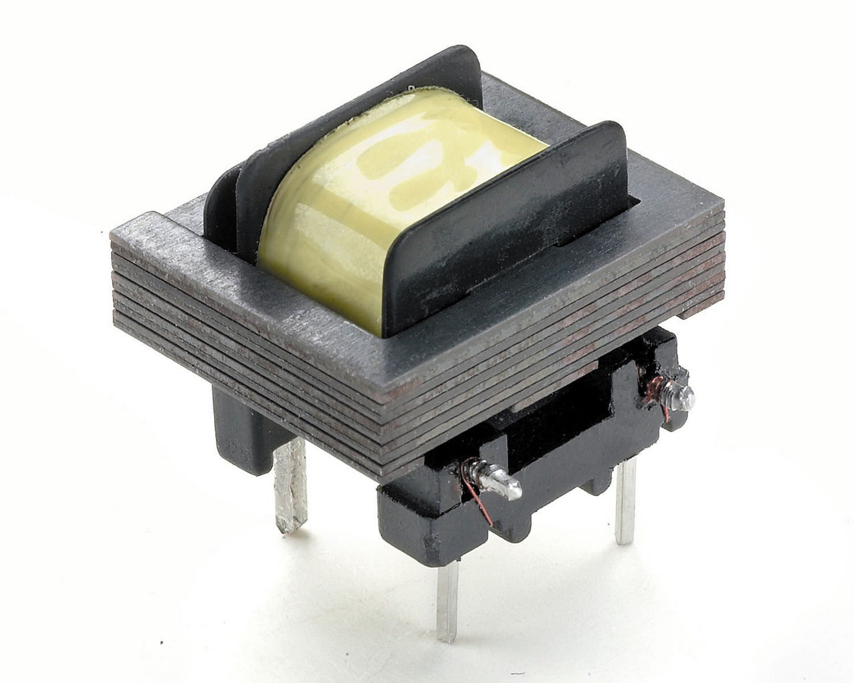
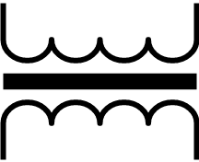
Transformer
Used to change the voltage of electricity.
A transformer is basically two or more inductors wrapped around a core (usually made from something like iron).

Slide 30
That’s all we need to know for now
We’ll talk more about electronics as we go along, but you’ll notice that new components/devices that we introduce will mostly be a variant or aggregation of the components we’ve seen already
For example, a transistor is actually two diodes stuck together!
If this interests you, I give a list of suggested readings in the lab, but none of them are mandatory!

Slide 31
Electronics intuition
Building intuition about how components behave can be useful, but don’t worry if you don’t fully understand what follows

Slide 32
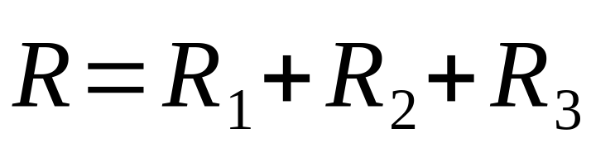
Resistors in series
The resistance of several resistors in series is equal to the sum of the resistance of the individual resistors

Slide 33
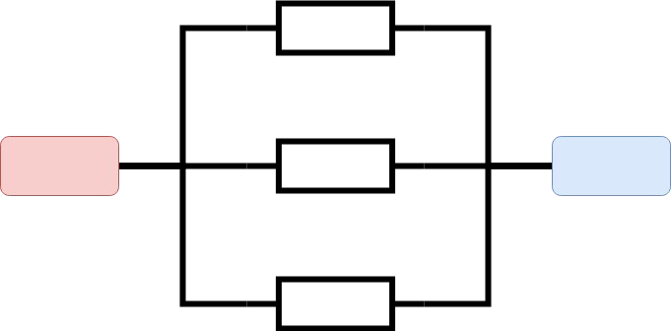
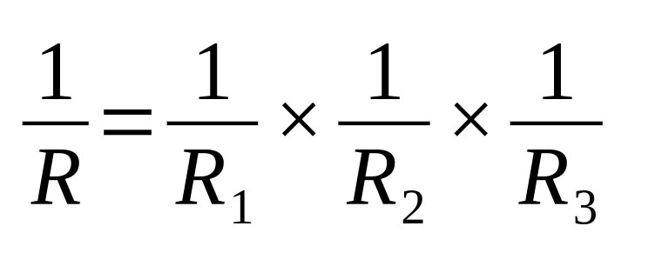
Resistors in parallel
By contrast, the resistance of several resistors in parallel is much more complicated!

Slide 34
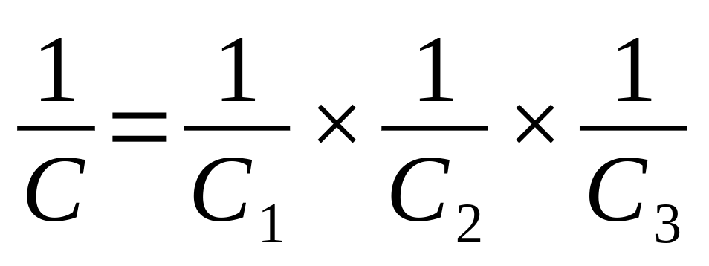
Capacitors in parallel and series
Capacitors work the other way around: the capacitance of multiple capacitors in parallel is the sum of the individual capacitances
The capacitance of multiple capacitors in series is:

Slide 35
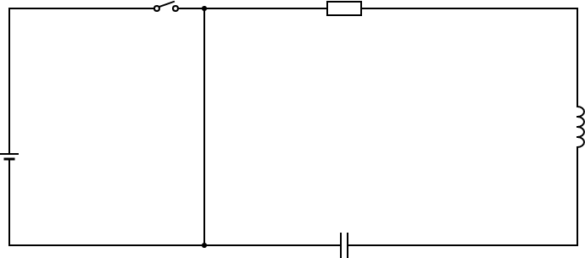
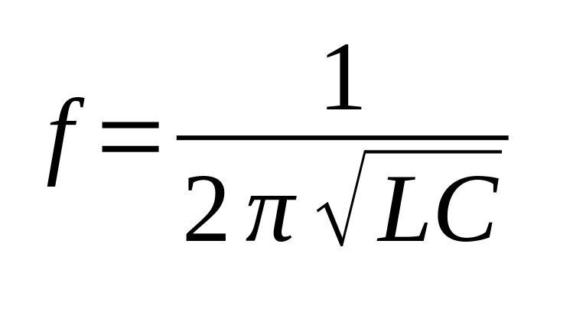
Example: RLC circuit

Slide 36
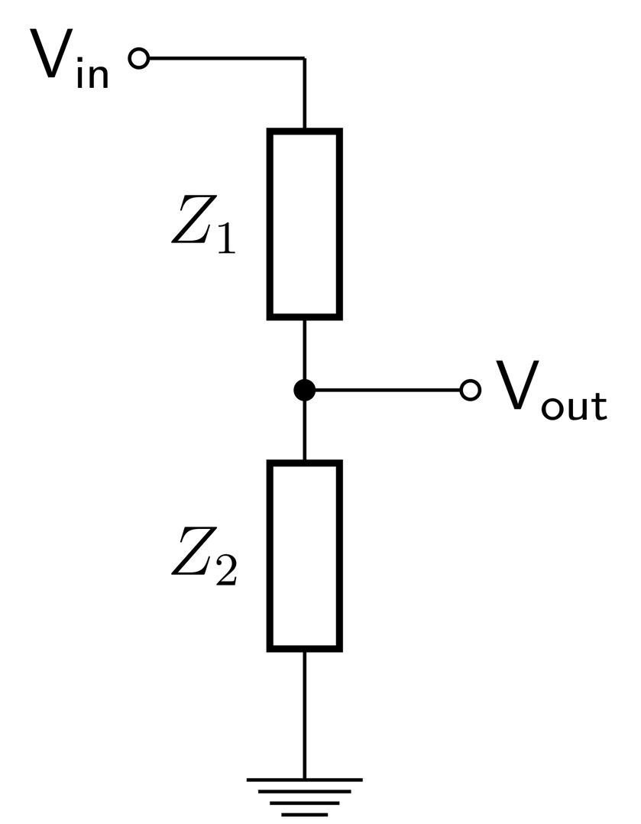
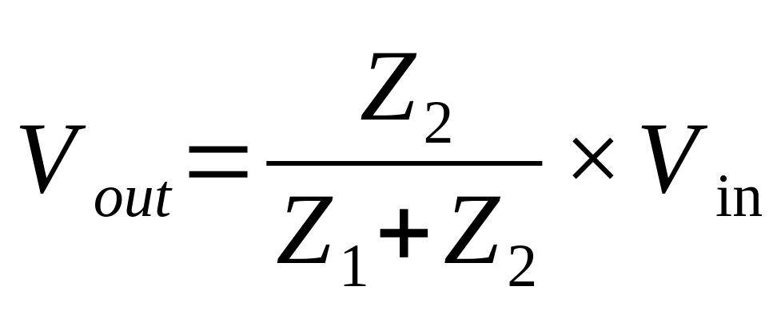
Example: Voltage divider

Slide 37
Summary
Computers are small and ubiquitous, and internet connections are fast and cheap
Putting a cheap computer into everyday electronic devices and connecting them to the internet allows us to create stuff that is cool and/or useful
This basic concept is called the Internet of Things (IoT)

Slide 38
Summary
We covered some basic electronic components:
Resistors, capacitors, inductors and diodes are very important
We covered two basic types of circuit:
RLC circuits
Voltage dividers

Slide 39
12
That’s all for this week
Thanks for your attention!

